Slide 1
PROJECT: FRAUD CLAIM PREDICTION Team 3 MENTOR: Mahesh <DATE:13/12/19>

Slide 2
To find out claims done by the hospital to insurance company are genuine or fraud.
Business Problem:

Slide 3
Exploratory Data Analysis (EDA):
The Insurance Data of Hospital set contains 34 variables and 10,48,575 obeservation.
Some of the variables contains' NA' values or missing values.
The data is in numeric and catagorical form.
There is a redundancy observed in the dataset from start to end.
But after observing Genuine and Fraudulent claimed which is Result Variable in the data with each columns it shows equal percent of obervation or equal proportionality , which is of 70-30 ratio.
So observing this we can not decide that in which field or in which vriable have more fraud cases.

Slide 4
Data set details
Total Rows | 1048575
Total Columns | 34
Total Missing Values | 1165292

Slide 5
Data Range:(of numeric variable)
Variable Name | Variable Range
Year discharge | 2012 2012
ccs_diagnosis_code | 1 670
ccs_procedure_code | 0 231
Code_illness | 0 4
Weight_baby | 0 9000
Tot_charg | 0.31 6196973.50
Tot_cost | 0.1 2562477.7
ratio_of_total_costs_to_total_charges | 0.03312909 157.55960920

Slide 6
Exploratory Data Analysis (EDA) and Feature Engineering

Slide 7
Overview of the features with NA values
Area_Service | 6.268452e-02
Hospital.County | 1.779509e+01
Certificate_num | 3.023790e+06
Hospital.Id | 1.023729e+03
Hospital.Name | 1.918273e+01
Age | 8.915242e-07
zip_code_3_digits | 6.082151e-01
Gender | 3.133614e-03
Cultural_group | 2.235665e-02
ethnicity | 3.554586e-01
Days_spend_hsptl | 1.964849e+00
Admission_type | 6.024342e-01
Home.or.self.care. | 6.287351e-03
year_discharge | 6.735232e-24
ccs_diagnosis_code | 7.219013e+01

Slide 8
ccs_diagnosis_description | 5.922868e+01
ccs_procedure_code | 7.708501e-03
ccs_procedure_description | 7.355510e+00
apr_drg_description | 2.775296e+01
apr_mdc_description | 3.724219e-01
Code_illness | 2.711768e-01
Description_illness | 7.682467e-01
Mortality.risk | 2.081808e-01
Surg_Description | 4.109193e+00
Payment_typology_1 | 5.476198e-01
payment_typology_2 | 1.868746e-01
payment_typology_3 | 5.123570e-02
Weight_baby | 2.207666e+02
Abortion | 1.576623e-02
Emergency.dept_yes.No | 3.273632e-01
Tot_charg | 2.963147e+05
Tot_cost | 1.661409e+05
ratio_of_total_costs_to_total_charges | 5.853449e-01

Slide 9
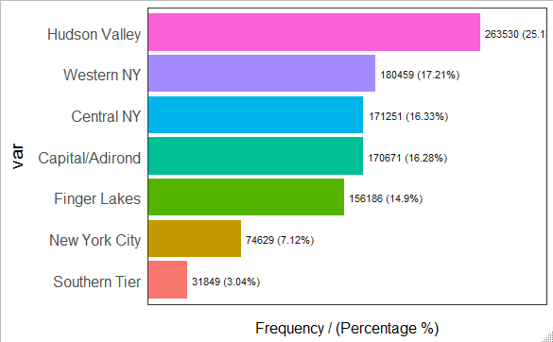
Detailed View of Data: 1.Area of service: When it comes to area of service of hospitals, Maximum number of cases is from Hudson Valley i.e. 263530 ,and minimum number of cases are from Southern Tier i.e. 31849

Slide 10
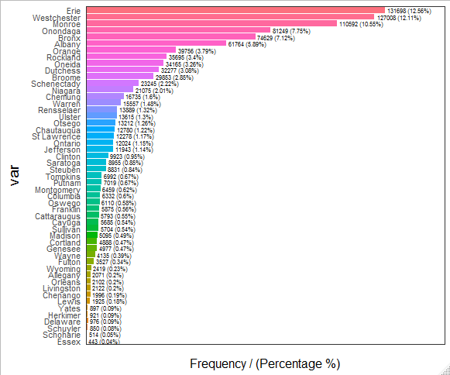
2.Hospital country (in which part or division of the country the hospital is located) : Country- ERIE with highest cases of 1,31,698 (12.56%) County- Essex has least number of cases ( 443 (0.04%) )and percentage of cases of remaining counties are as shown in the plot attached.

Slide 11
3.Certificate number: For the following feature , as it is consisting of more levels, cannot plot it graphically. There are total 2456 missing values in this column and are being replaced by the mode of the column i.e. 1401014. NOTE: - There is no plot available because of the huge number of components.
4.Hospital Id:
There are total 2456 missing values in this column and it is replaced by the mode of the column i.e. 413. Consists more levels, cannot plot it graphically.
NOTE: - There is no plot available because of the huge number of components.
5.Hospital name:
Most of the cases were recorded in STRONG MEMORIAL HOSPITAL of 40,824 while only one was recorded in HEALTH ALLIANCE HOSPITAL BRODWAY COMPANY.
NOTE: - There is no plot available because of the huge number of components.

Slide 12
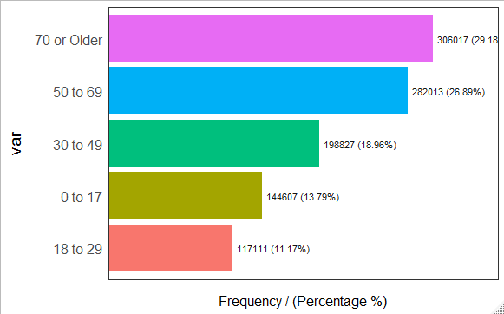
6.Age (age of the patient): Column name- Age By the observation of data given we come to a conclusion that people aged of 70 and above were affected in more number as 3,06,017 contributing 29.18%, whereas teens in between 18-29 were affected at a lower scale ( 1,17,111 contributing 11.17%) . Meanwhile remaining age grouped people are affected as shown in the plot.

Slide 13
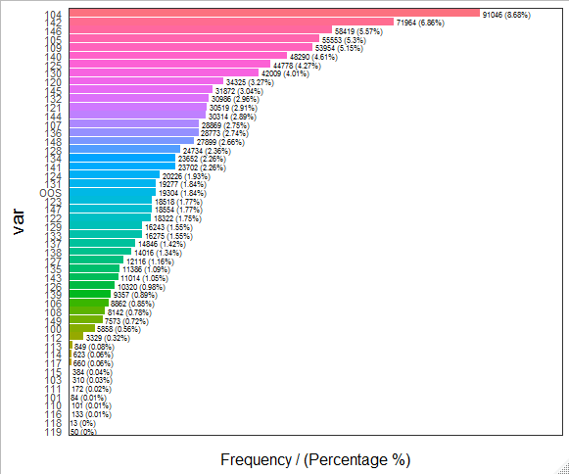
7.Zip codes (postal codes): Column name- zip_code_3_digits Most of the cases were found from the zip code 104 i.e. 91046 (8.86%) and least number of cases was found from the zip code 119 i.e. 50 (0%). The data with proportion of 19304 (1.84%) were from OOS (out of state).

Slide 14
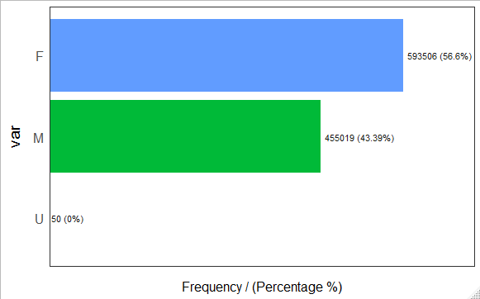
8.Gender( male or female): Total 5,93,506 diseased were male and 4,55,019 were female i.e. 43.39% and on the other hand 50 people been stated as Unknown. This shows that 56.6% of total patients were males.

Slide 15
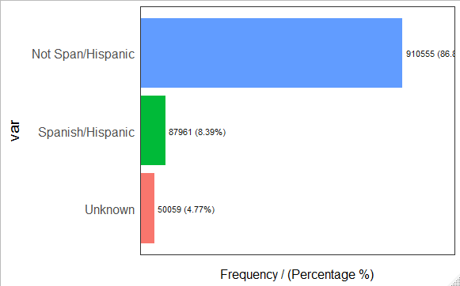
9.Cultural group( race of people): When it comes to cultural group whites are joined in hospitals in huge number of 7,81,658. This comes around 74.54% of total races. There are 3832 unknown race i.e. 0.37% 10.Ethnicity: Column name- ethnicity The Hispanic/Not Span component almost contributes 86% with count of 910555, Spanish and Unknown contributing almost 8% and 4% each

Slide 16
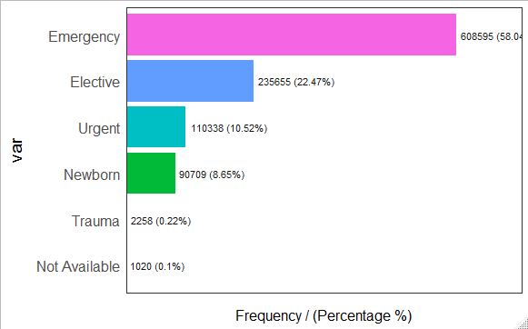
11. Days spend by patient in hospital: NOTE: - There is no plot available because of the huge number of components. Most of the cases are of emergency of about 6,08,595 cases. Which comes of 58.04% of total cases and trauma cases are very minimum with just 0.22% of just 2,258 cases of total.

Slide 17
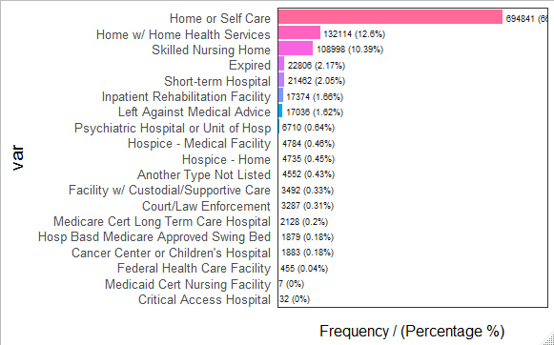
14.Home or self care: Column name- Home.or.self.care As per the given data 694841 patients opted self-care at home, which mean more than half I.e. 66.27% of the patients are under self-care and least of 455 patients i.e. 0.04% patients were under federal health care facility. None of the patients were opted to Medicaid Cert Nursing Facility or Critical Access Hospital

Slide 18
15.Year discharge( patient discharge year): Column name- year_discharge This column keeps the records of patient discharge year from the hospital. 16.Particular code for disease: Column name- ccs_diagnosis_code This column keeps the records of the disease code. 17. Name of the disease: Column name- ccs_diagnosis_description This column keeps the record of the name of the diseases. 18. Procedure code which the hospital has followed: Column name- ccs_procedure_code This column keeps the record of the procedure code which the hospital has followed. 19. Name of the procedure followed by the hospital: Column name- ccs_procedure_description This column keeps the record of the name of the procedure which the hospital has followed. 20. Classification system that classifies patients according to their reason of admission, severity of illness and risk of mortality: Column name- apr_drg_description This column keeps the record of the patients according to their reason of admission, severity of illness and risk of mortality.

Slide 19
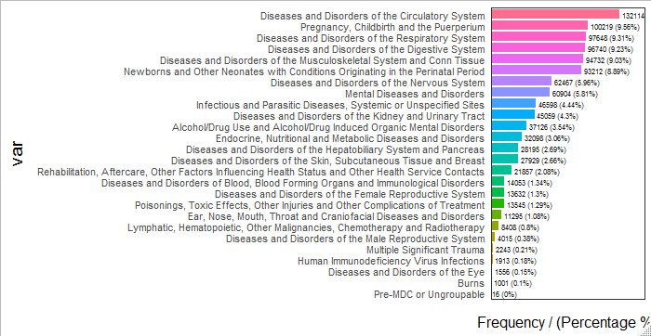
21. Medical description: Column name- apr_mdc_description Saddest part here is there are lots of cases with Diseases and Disorders of the Circulatory System which comes exactly 1,32,114, i.e. 12.6 % people and just 0.1% of people are of burns cases.

Slide 20
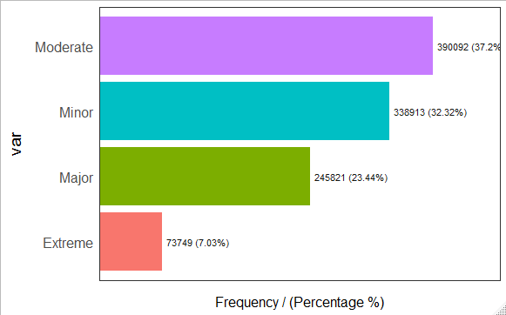
22. Code for patient’s disease, disorder etc.: This column keeps the record of the code for patient’s disease, disorder etc. 23. Description illness:

Slide 21
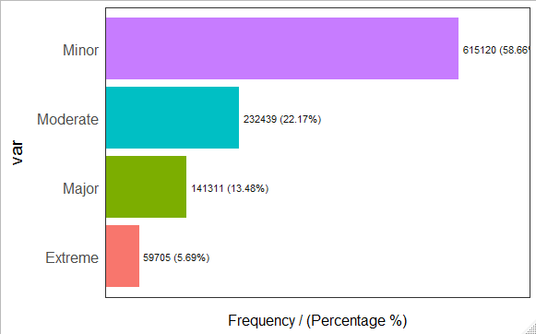
24. Mortality risk: Most of the cases are of minor mortality risk with 58.6% of total number of cases with 615120 patients. 59705 cases are of extreme mortality risk which consists of just 5.69% of total patients.

Slide 22
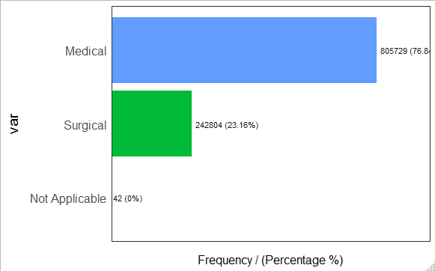
25. Surgery description: The Medical component contributes almost 76% , surgical with 23% .

Slide 23
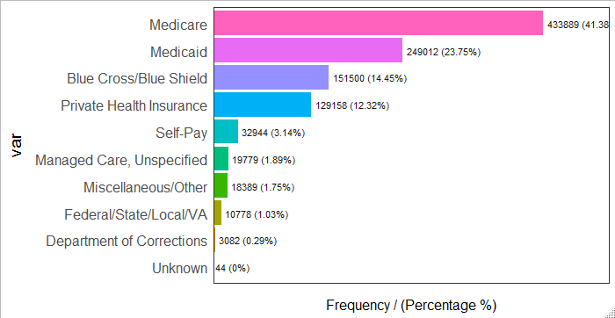
26.Payment topology: Column name- payment_topology_1 By the keen observation we came to know that almost half of the patients i.e. 41.38% (4,33,889) were using only Medicare insurance whereas very few of them i.e., 0.29% of them are using Department of corrections and remaining are using all other health insurance. Þ Very few of them which is just 3.14% i.e. 32,944 people only were not using any type of insurance.

Slide 24
27.TOTAL COST: Hospitals charged minimum of zero and maximum of 25,62,477.7. 28.TOTAL CHARGE: - Hospitals claimed minimum of zero to maximum of 61,96,974. 29.RATIO OF TOTAL COST TO TOATAL CHARGE: Hospitals claimed minimum of 0.03313 to maximum of 157.55961 times more than the total cost. 30.TOTAL COST: Hospitals charged minimum of zero and maximum of 25,62,477.7. 31.TOTAL CHARGE: - Hospitals claimed minimum of zero to maximum of 61,96,974.

Slide 25
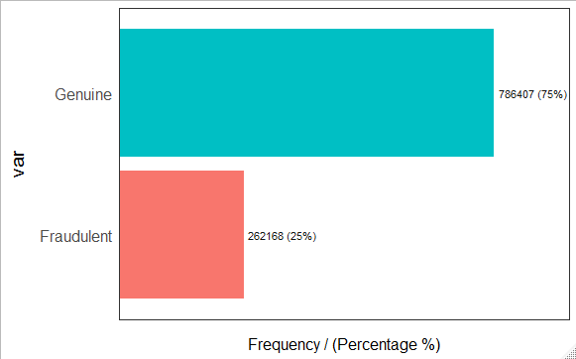
32.RATIO OF TOTAL COST TO TOATAL CHARGE: Hospitals claimed minimum of 0.03313 to maximum of 157.55961 times more than the total cost.

Slide 26
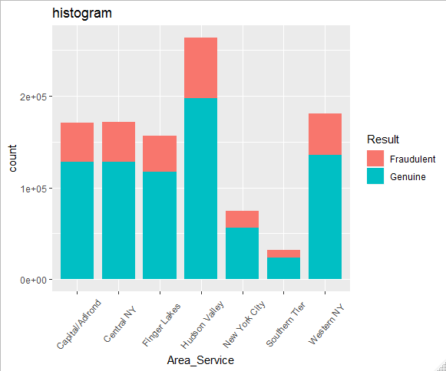
COMPARISION: (with RESULT )
Area_service vs Results
When we go with the data given under the area of service, most of the fraudulent claims were made in Hudson Valley area whereas Southern Tier area has a smaller number of fraudulent claims.

Slide 27
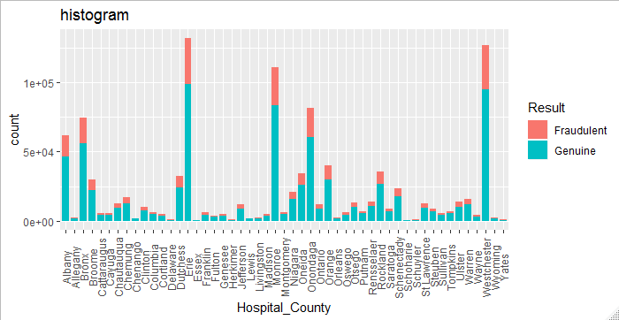
Hospital.Country vs Results

Slide 28
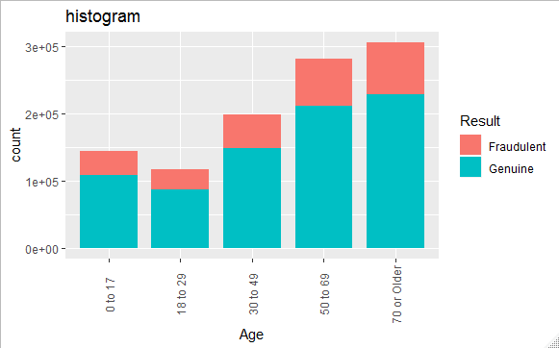
Age vs Results

Slide 29
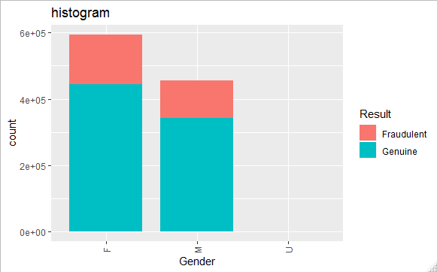
Gender vs Results

Slide 30
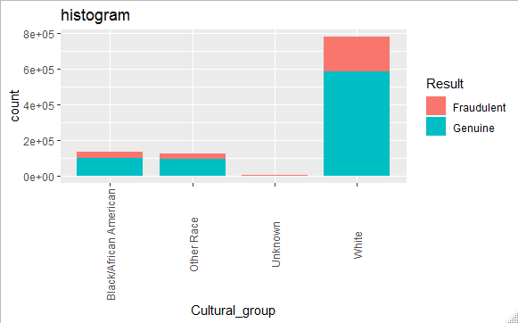
Cultural_group vs Results

Slide 31
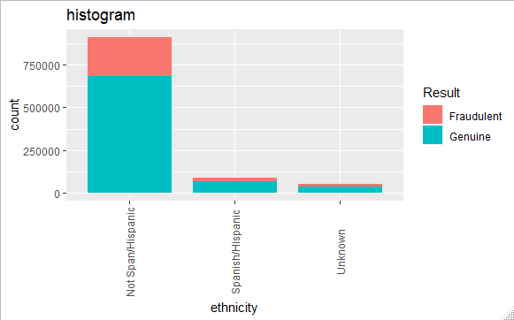
Ethnicity vs Results

Slide 32
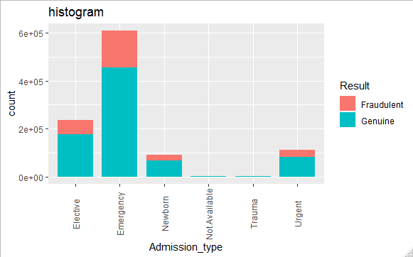
Admission_type vs Results

Slide 33
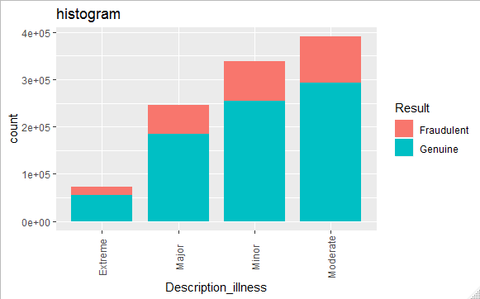
Description_illness vs Results

Slide 34
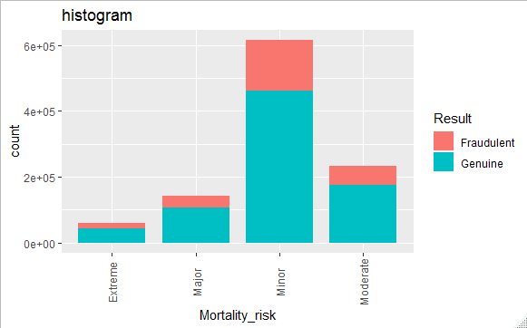
Mortality risk vs Result

Slide 36
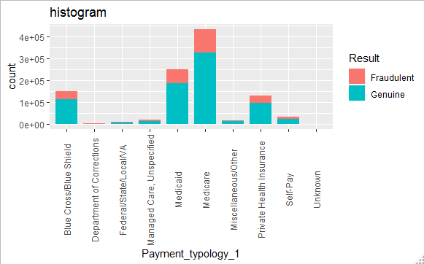
Payment_topology_1 vs Results

Slide 37
OTHER MODELS TESTING RESULTS
Sr.No | Model | Overall Accuracy | Sensitivity | Specificity | Kappa value
1. | Decision Tree | 49.33% | 0.5033 | 0.4900 | 0.005
2. | Naive Bayes (Oversampling) | 74.37% | 0.011794 | 0.988310 | 2e-04
3. | Naive Bayes (Undersampling) | 67.56% | 0.1489 | 0.8515 | 5e-04
4. | Naive Bayes | 63.02% | 0.24312 | 0.75956 | 0.0027

Slide 38
Model Results
FINAL MODEL : NAIVE BAYES (Undersampling)
MODEL | NAIVE BAYES
MEAN MODEL | 0.6755682
ACCURACY | 67.56%
CONFUSION MATRIX AND STATISTICS
Reference
Prediction | Fraudulent | Genuine
Fraudulent | 12425 | 37069
Genuine | 71008 | 212625

Slide 39
P-value | 1
kappa | 5e-04
Sensitivity | 0.1489
Specification | 0.8515
Pos Pred Value | 0.2510
Neg Pred Value | 0.7496
Prevalence | 0.2505
Detection Rate | 0.0373
Detection Prevalence | 0.1486
Balanced Accuracy | Balanced Accuracy
Positive Class | Fraudulent

Slide 40
METHOD USED IN MODEL BUILDING:
Undersampling.
Oversampling

Slide 41
Model Deployment using R shiny / Flask or any other method

